Slide 1




IRE 211: IoT Architecture and Technologies
CoAP
Group Name: Access Unknown
Presented By:
Mobashira Mehajabin Arpita ...........2101008
Rupu Rani Ghosh ......................... 2101010
Meherin Farazana .......................... 2101013
Department of IRE
Bangabandhu Sheikh Mujibur Rahman Digital University, Bangladesh.
Presented To:
Saurav Chandra Das
Lecturer,
Department of IRE
Bangabandhu Sheikh Mujibur Rahman Digital University, Bangladesh.

Slide 2
Presentation Outline
Introduction of CoAP
Architecture of CoAP
Structure of CoAP
CoAP Messages Model
CoAP Request/Response Model
Message Formate

Slide 3
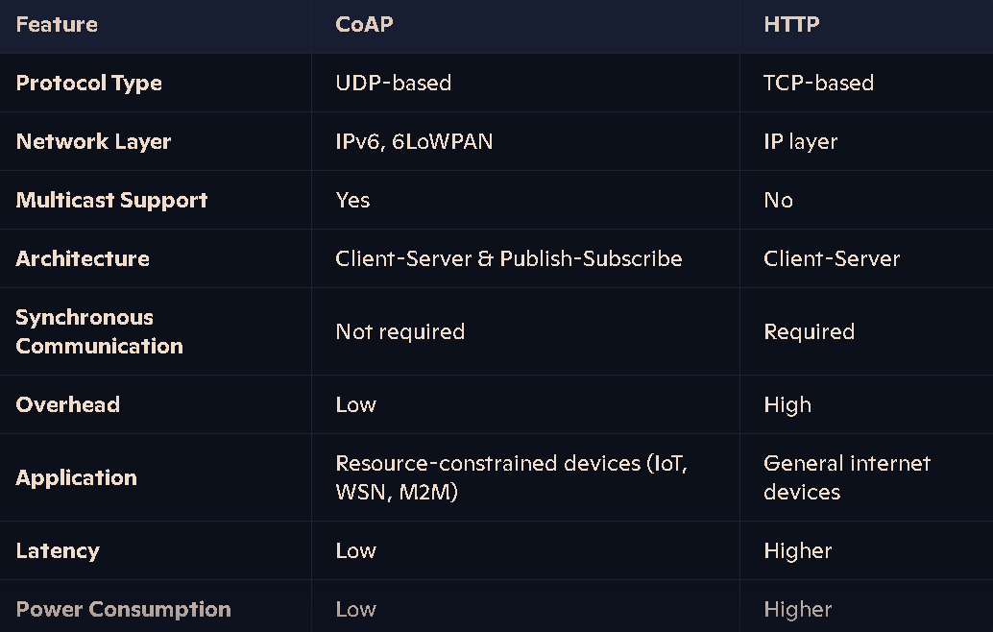
Introduction of CoAP
Constrained Application Protocol or CoAP
- is a specialized web transfer protocol for use with constrained devices (ae. microcontrollers) and constrained networks in IoT.
- is designed for machine-to-machine (M2M) applications such as smart energy and building automation.

Slide 4
Architecture of CoAP
Client-Server Model: CoAP follows a client-server architecture similar to HTTP but optimized for IoT. Devices in a CoAP network can act as clients, servers, or both. Clients initiate communication by sending requests to servers, which respond with the relevant data or actions.
Message Types: CoAP uses two main types of messages: requests and responses. These messages are encoded in a simple binary format to minimize overhead.
Transport Protocol: CoAP is typically bound to UDP (User Datagram Protocol), which is suitable for low-power and lossy networks. It can also be used with DTLS (Datagram Transport Layer Security) for secure communication.
RESTful Designe: CoAP is designed to be RESTful, meaning it uses standard methods like GET, POST, PUT, and DELETE to interact with resources. This makes it easy to integrate with web technologies.
Proxy and Translation: CoAP supports proxying and can translate to HTTP, allowing constrained devices to communicate with the broader internet.

Slide 5
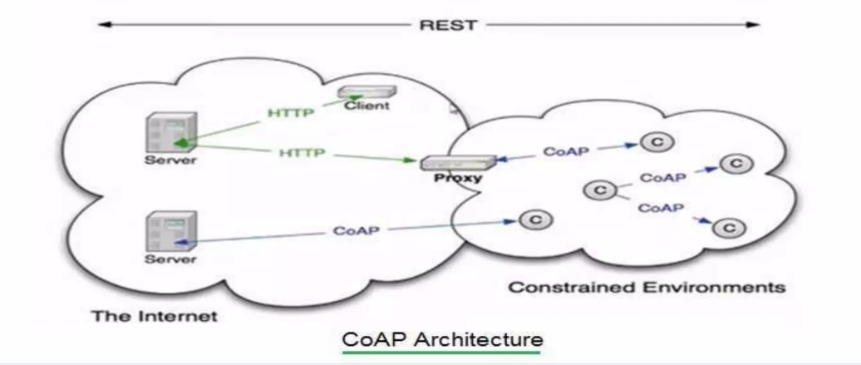
Architecture of CoAP
Key Components-
Endpoints: Nodes that host resources and can act as clients or servers.
Clients: Devices that send requests to servers.
Servers: Devices that respond to client requests.
Proxies: Devices that bridge communication between CoAP and other protocols like HTTP.

Slide 6
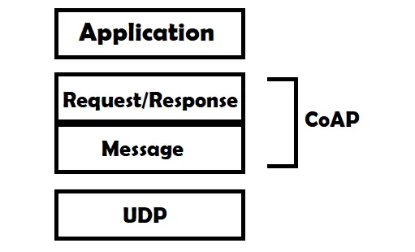
Structure of CoAP
Message Layer
Purpose: Responsible for the transport of messages between devices.
Key Role: Ensures reliability and ordering of messages, using mechanisms like confirmable (CON) and non-confirmable (NON) messages.
Request/Response Layer
Purpose: Manages the actual data exchange between the client and the server.
Key Role: Maps CoAP requests (like GET, POST, PUT, DELETE) to server resources and provides responses.
Message layer is meant for Re-transmitting lost packets. Request/Response layer contains methods like GET, PUT , POST and DELETE.

Slide 7


Structure of CoAP
The message layer in CoAP supports four types of messages, each serving a specific purpose:
Confirmable (CON): Ensures reliable delivery by requiring an acknowledgment (ACK).
Ex: Like sending a registered letter—you need confirmation it was received.
Non-confirmable (NON): Used for non-critical messages where reliability is not essential
Ex: Like sending a postcard—no confirmation required
Acknowledgment (ACK): Confirms the receipt of a confirmable (CON) message.
Ex: Like replying with "Message received!" to a text.
Reset (RST): Indicates that a message was received but could not be processed (e.g., due to an error).
Ex: Like saying, "I don’t understand this message—please try again!"

Slide 8


Common Terms of CoAP
Endpoint: An entity that participates in the CoAP protocol. Usually, an Endpoint is identified with a host.
Sender: The entity that sends a message.
Recipient: The destination of a message.
Client: The entity that sends a request and the destination of the response.
Server: The entity that receives a request from a client and sends back a response to the client.

Slide 9
CoAP Messages Model
CoAP Message is lowest layer and deals with UDP exchanging messages between endpoints. The Constrained Application Protocol (CoAP) message model is a client/server, request/response communication model that uses UDP to exchange messages between endpoints:
Unique ID: Each CoAP message has a unique ID to prevent duplicate messages.
Parts: A CoAP message is made up of three parts: a binary header, compact options, and a payload.
Header: The header is a fixed 4-byte header that contains the CoAP version, type, and token length.
Code(8bit): The code is split into two parts: a class(3 bit) range(0-7), and a detail(5 bits) range(0-31).
Message size: CoAP messages should generally be limited to 1280 bytes, with a payload of 1024 bytes.

Slide 10
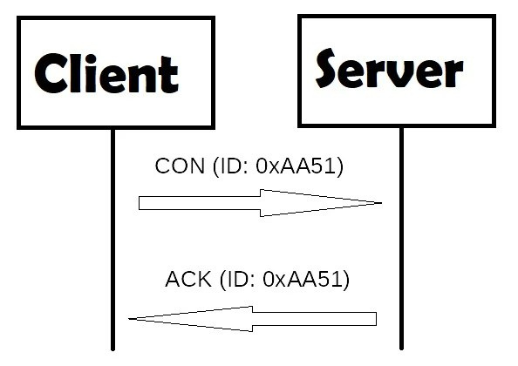
CoAP Confirmable message
A CoAP confirmable message is a reliable message. During exchanging messages between two endpoints, these messages can be reliable. In the CoAP protocol, a reliable message is obtained using a Confirmable message (CON). Using this kind of message, the client can be sure that the message will arrive at the server. A CoAP Confirmable message is sent again and again until the other party sends an acknowledge message (ACK). The ACK message contains the same ID of the confirmable message (CON).

Slide 11
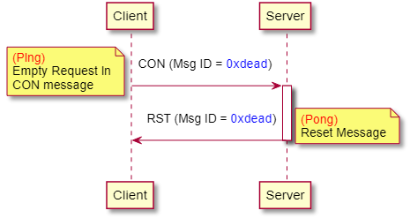
CoAP Confirmable message
If the server has troubles managing the incoming request it can send back a Rest message (RST) instead of the Acknowledge message (ACK).

Slide 12
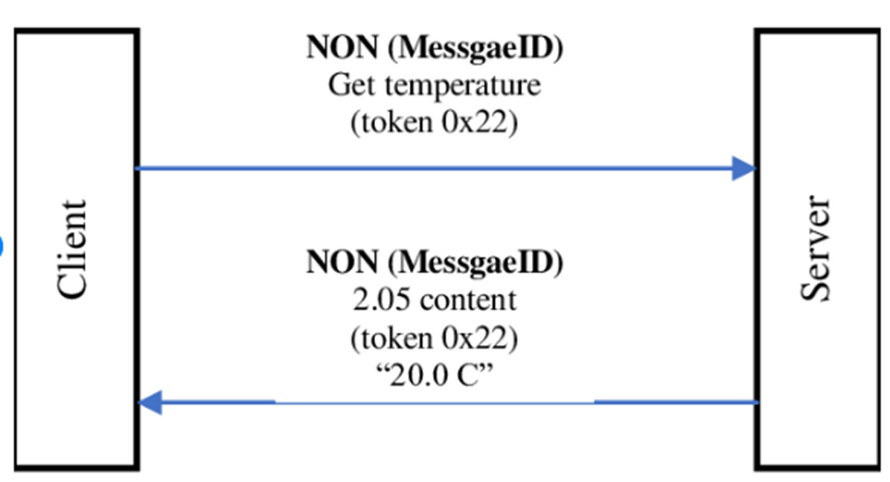
CoAP nonConfirmable message
Non-confirmable (NON) messages that don’t require an Acknowledge by the server.
These mesages are unreliable messages means do not contain critical information that must be delivered to the server.
To this category belongs messages that contain values read from sensors.
Even if these messages are unreliable, they have a unique ID.

Slide 13
CoAP Request/Response Model
The CoAP Request/Response is the second layer in the CoAP abstraction layer.
The request is sent using a Confirmable (CON) or Non- Confirmable (NON) message.
There are several scenarios depending on if the server can answer immediately to the client request or the answer if not available.

Slide 14
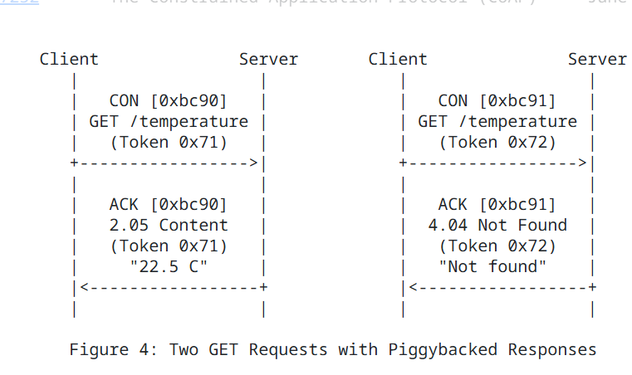
Confirmable Request/Response
Piggybacked Responses
If the server can answer immediately to the client request, then if the request is carried using a Confirmable message (CON), the server sends back to the client an Acknowledge message containing the response or the error code
Figure: Two GET Requests with Piggybacked Responses

Slide 15
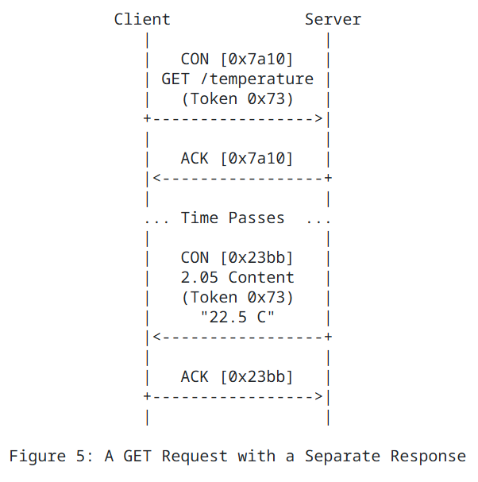
Separate Response
If the server cannot respond immediately to a Confirmable (CON) request, it sends an Empty Acknowledgement (ACK) message to stop the client from retransmitting the request.
Once the response is ready, the server sends it in a new Confirmable message, which the client must acknowledge; this is called a separate response.
Figure: A GET Request with a Separate Response

Slide 16
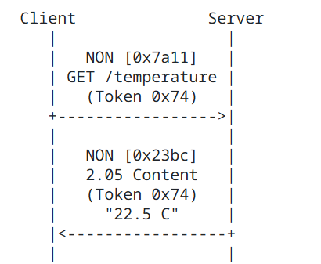
NON-confirmable Request/Response
If the request coming from the client is carried using a NON-confirmable message, then the server answer using a NON-confirmable message.
Figure: Request and a Response Carried in
Non-confirmable Messages

Slide 17
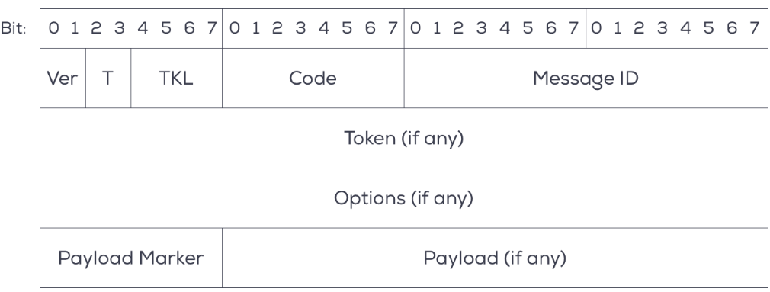
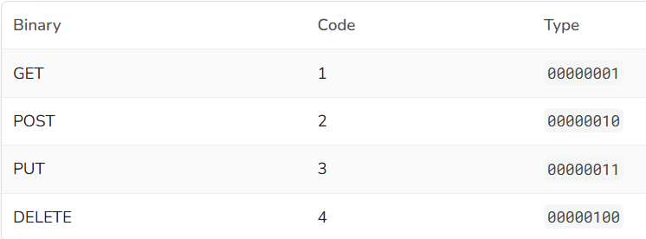
Message Format in CoAP
Version (2 bits): Indicates the CoAP version (currently 1).
Type (2 bits): It is a 2 bit unsigned integer indicating the message type: 0 confirmable, 1 non-confirmable, 2 ACK ,3 RESET
TKL (4 bits): Length of the Token field (0-8 bytes).
Code (8 bits):
Request: Specifies the method (e.g., GET = 0.01, POST = 0.02).
Response: Indicates the status (e.g., 2.05 for success).
Message ID (16 bits): Used for matching requests and acknowledgements

Slide 18
Example Question
In a smart home system, CoAP is used for communication between the homeowner and the central server to change the room temperature. The homeowner sends a request to set the temperature to a desired value.
Question:
1.Which CoAP method and message type would be used for the homeowner's request to change the room temperature, and why?
2.How can the server ensure that the homeowner's request to change the temperature is processed only once, even if the message is retransmitted?

Slide 19
Example Question
A smart agriculture system uses CoAP for communication between sensors and a central server. The system includes temperature and soil moisture sensors deployed in the field. These sensors send data to the server periodically. Additionally, the server allows farmers to request real-time sensor readings.
Question:
1.Why might CoAP be preferred over HTTP in this system?
2.When a farmer wants to retrieve the current soil moisture reading from the sensor: What CoAP method and message type should be used?Explain how the server can respond using a piggybacked response.

Slide 20


